Slide 1
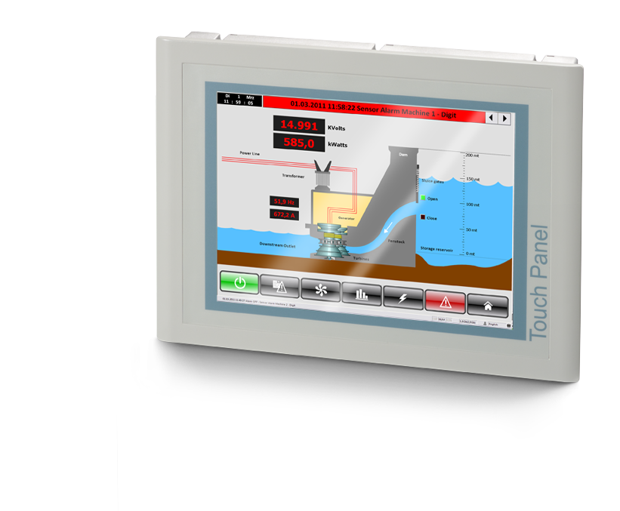
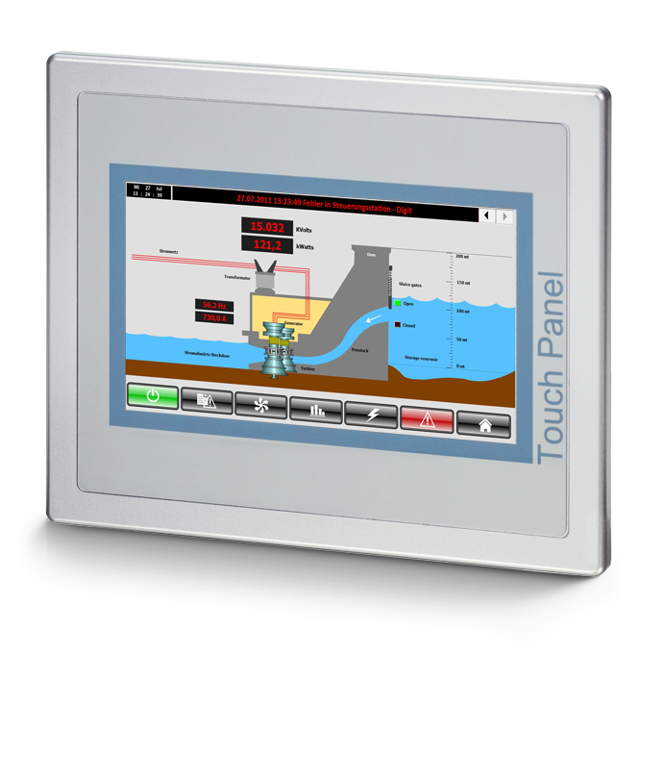
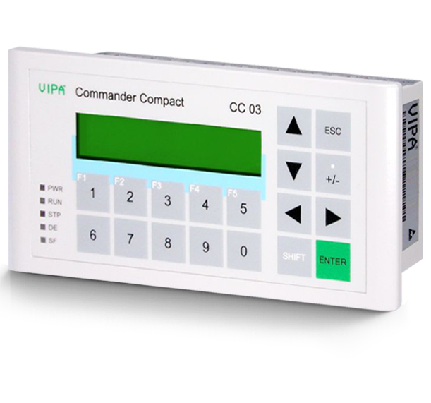
HMI: operating and monitoring
The whole range.

Slide 2
The whole range of Hmi.
What is it anyway?

Slide 3
Operating and monitoring.
This runs of course mostly via PCs, Cloud Computing or via Teleservice even via Smartphone. Yet hundreds of thousands of HMI interfaces are used around the world. They are indispensible because the modern Touch Panels can do a great deal!
But sometimes the high-end panel is not at all necessary or the line display nowhere near enough. It‘s better if you have the choice to find exactly the right one for your application.

Slide 4
Free choice for Operating and monitoring
Line Displays
eco Panels
professional Panels
GO
GO
GO

Slide 5
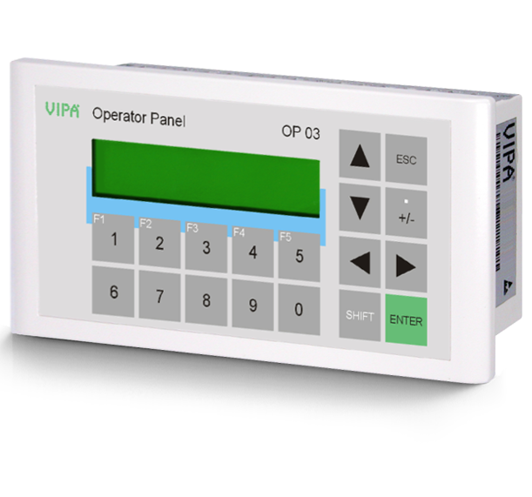
Line displays
The simple, low-cost entry into the world of HMI.

Slide 6
Operating and monitoring can be so easy.
Line displays are the simple and extremely low-cost HMI classic. They are so simple that pretty much every provider has taken them off the program. Not VIPA.
Because for basic tasks they are perfectly adequate. Why spend more?
They are completely foolproof.
Displayed texts are always easy to read due to the backlit LCD screen.
They are so robust and simply constructed, they can even be operated with protective gloves.
Their usage is extremely space-saving. And no matter what display you use: The control cabinet cut-out is always the same size.
They can be individually customized– with your logo, instructions or whatever it may be.
Line displays have become very rare on the market. We still have them in our program. This is because of our sustainable product policy.
But also because our customers are still asking for line displays. And we want our customers to be satisfied.

Slide 7
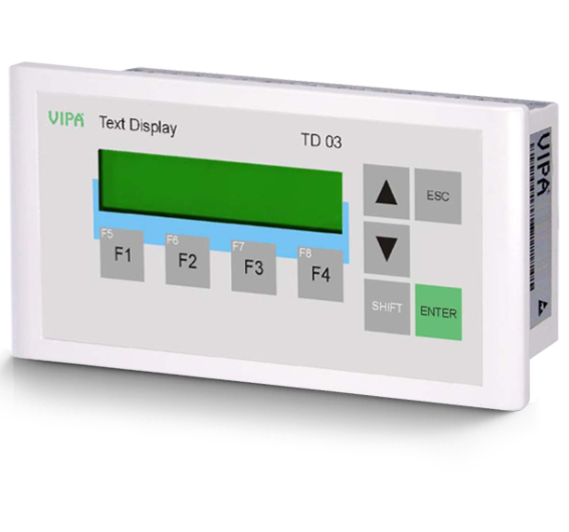
Three with inner values.
All have parametrizable function keys, an MPI interface and multilingual language support. And all cover the HMI basic needs, but with subtle differences.
Text display TD 03
Designed for use with VIPA CPUs and CPUs from Siemens.
Programmable with VIPA OP-Manager or ProTool from Siemens.
Operator Panel OP 03
For control and monitoring of small applications.
Designed for use with CPUs from VIPA and CPUs from Siemens.
Programmable with VIPA OP-Manager or ProTool from Siemens.
Commander Compact CC 03
Control display and panel in one, because on the back sits a VIPA 100V PLC which among others is programmable with STEP7 from Siemens .
Programmable with STEP7 from Siemens.
16 digital inputs and outputs.
Programmable with VIPA OP-Manager or ProTool from Siemens.
Back to overview
References

Slide 8
eco Panels
Half price, full service.

Slide 9
The eco Panel:
What is it anyway?

Slide 10
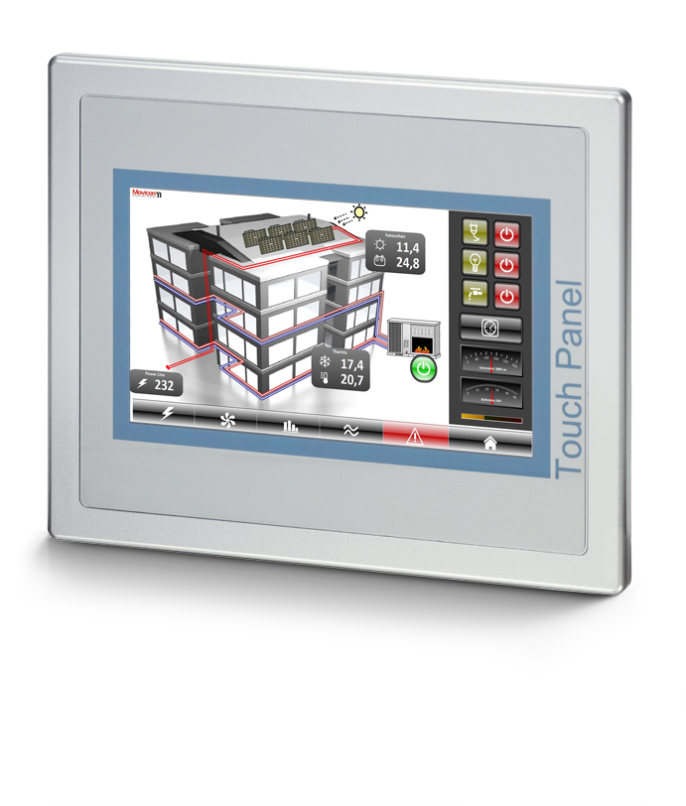
Often, it must be a touch panel. Nothing less, but also nothing more.
The eco Panels from VIPA are solid Touch Panels, which are not afraid of any common type of operation. Because we have taken two things into account during development.
Quality: eco Panels are durable and robust.
Functionality: eco Panels come with preinstalled Movicon Runtime.
As a result panel and panel software are perfectly aligned with each other. And that means:
High scalability.
Significant performance improvement for every project.

Slide 11
eco Panels:
Your benefits.

Slide 12
Tariff: Economy. class: Big Business.
Notable features:
Integrated PLC function: For basic applications you do not need a control system any more – the PLC program in the eco Panel is completely sufficient for this.
The operating system and Movicon Runtime are already installed for you.
Powerful processor.
Big choice of interfaces: USB, Ethernet, serial (RS232/422/485), MPI/DP (optional).
Extended licence: The process on the panel can also be utilized on the PC in the control room without having to configure again.
Particular feature:
The diagnostics buffer of the connected CPU can be read directly.
eco Panels are also a sustainable intestment:
They are so robust that they last an extremely long time.
They will continue to be available for a long time – promise.

Slide 13
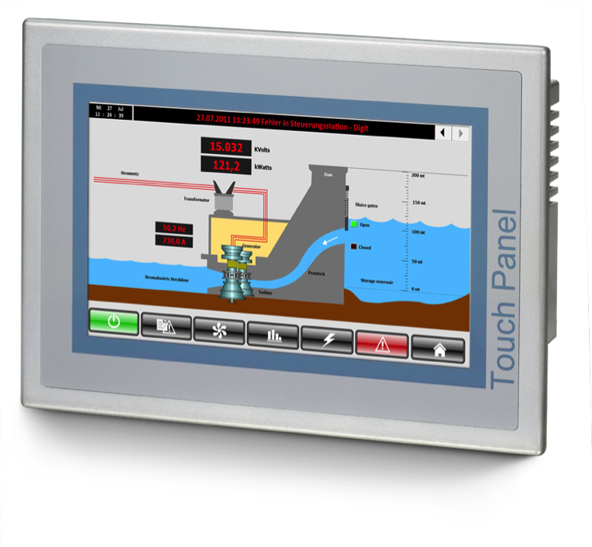
It‘s flexible, and makes you flexible.
Open for everything:
Compatible with all systems, also of other manufacturers. Because the necessary drivers are present: Modbus RTU, Modbus TCP, MPI-PC-Adapter, PPI, S5-CPU, S7-TCP, VIPA-MPI and VIPA-PROFIBUS-DP-Slave. Additional drivers can easily be installed at a later date.
Open for you:
eco Panels are so flexible, that you can program every application in your company yourself.
Open for Teleservice:
With the help of a convenient VNC client software you also have access to your eco Panel via Teleservice.
Open for systems of other CPU manufacturers
Open for every
application
Upgradable for Teleservice.

Slide 14
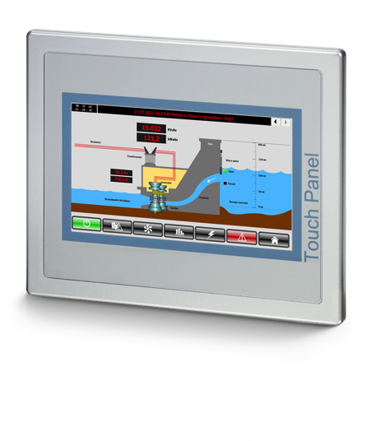
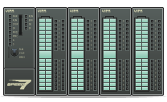
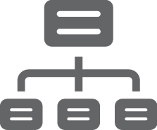
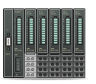
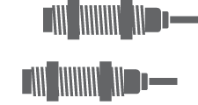
The Panel that is open for everything.
The eco Panel solves basic tasks thanks to the integrated PLC function completely without a control system.
And of course communication also runs with all elements of the engineering level.
eco Panels communicate with all control systems.
Also I/O systems can be controlled directly.
Industrial Ethernet
SQL-Database
ERP & MES
Condition Monitoring

Slide 15
eco Panels: Features and Data
All you need to know at a glance.

Slide 16
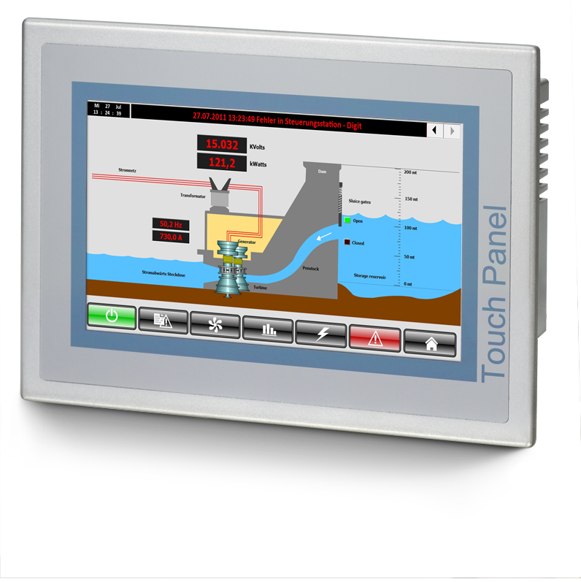
eco Panels in Detail
Five interfaces: 1x RS232 (SUB-D), 1x RS232/422/485 (DB25), 1x USB-A, 1x Ethernet (RJ45), 1x MPI/PROFIBUS-DP (optional).
Remote control possibility via PC or Smartphone.
Available in two different sizes: 4,3“ und 7“.
Mounting depth 55 to 60 mm.
Industrial-grade, robust plastic housing.
Multilingual language support.
References
Comparison with professional Panel
Back to overview

Slide 17
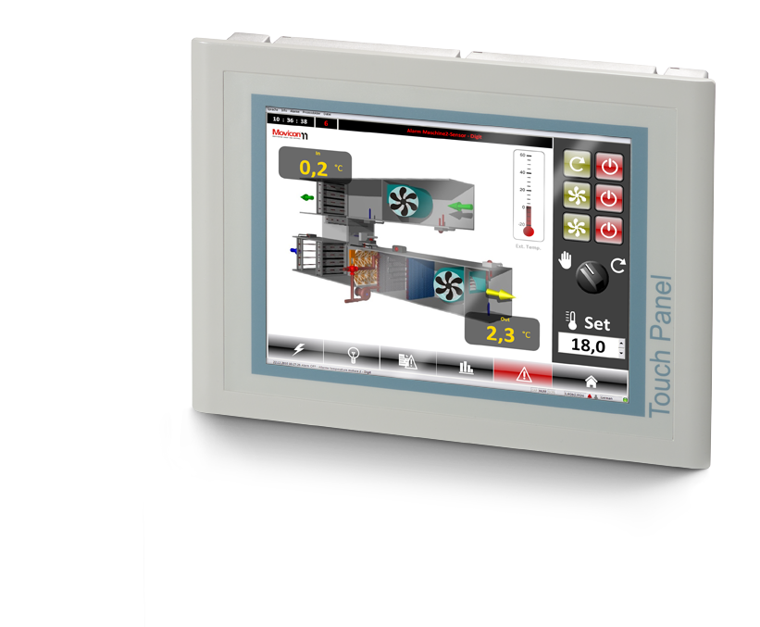
Professional Panels
The all-rounder.

Slide 18
The professional Panel:
What is it anyway?

Slide 19
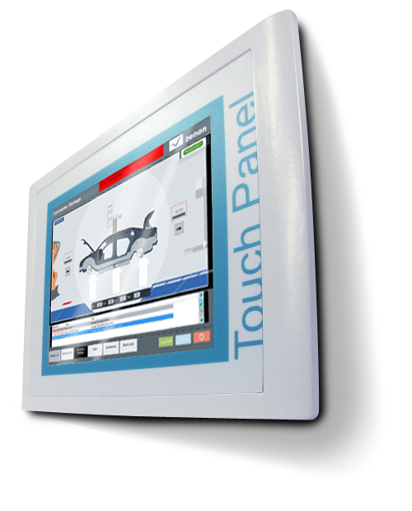
The full equipment for full professionals.
professional Panels are extremely powerful Touch Panels with unique features.
High scalability.
Significant performance improvement for every project.
Considerable capabilities:
Integrated PLC function: For basic applications you do not need a control system any more– the PLC program in the professional Panel is completely sufficient for this.
The diagnostics buffer of the connected CPU can be read directly.
The panels can be operated both vertically and horizontally.
Notable features:
Powerful XScale processor with 800 MHz: ultra-fast (as a rule Touch Panels only have around 500 MHz).
User memory / working memory: 2.048 MB (Flash) / 128 MB (RAM).
Up to 8 interfaces.
Perfect control by resistive touch display.

Slide 20
professional Panels:
Your benefits.

Slide 21
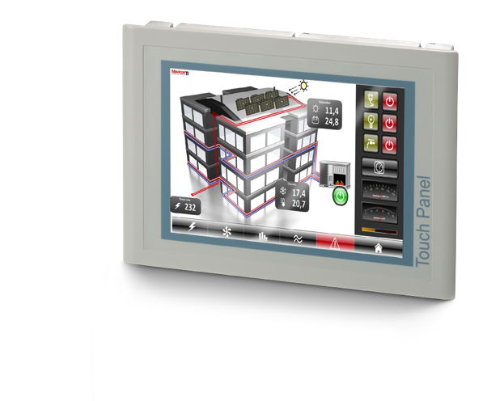
The Touch Panel with a touch of ingenuity.
professional Panels have an integrated web server. And that brings you a giant step further.
With the professional Panels a database comunication is much easier to achieve .
That means that a fast and easy system control can take place.
Also the controlling of the system is thereby state of the art: All professional Panels of your production plant can be operated from any PC in your company, via a free VNC client or already via many standard web browsers. Completely without any additional software.
But it doesn‘t have to stop there: professional Panels are capable of Teleservice.
Due to the built-in Ethernet interface in the panels you also have the possibility of reaching your panels deployed worldwide via the VIPA Teleservice solution.
Access to the web server to control and monitor your plant as well as a preventive alert for service purposes is no problem for us. Our products are perfectly aligned with each other for this.

Slide 22
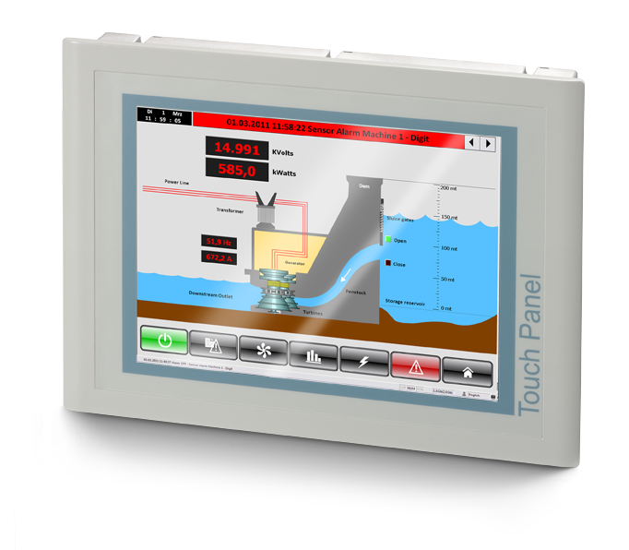
It‘s flexible, and makes you flexible.
Open for everything:
Compatible with all systems, also of other manufacturers. Because the necessary drivers are present: Modbus RTU, Modbus TCP, MPI-PC-Adapter, PPI, S5-CPU, S7-TCP, VIPA-MPI and VIPA-PROFIBUS-DP-Slave. Additional drivers can easily be installed at a later date.
Open for you:
professional Panels are so flexible, that you can program every application in your company yourself.
Choose what you need: With or without Movicon-Runtime (so that you can install your own runtime engine).
Open for systems of other CPU manufacturers
Open for every application
Open for your runtime

Slide 23
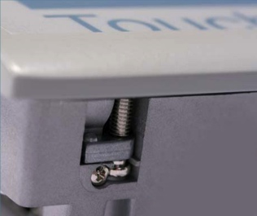
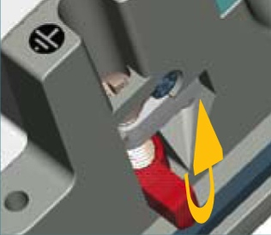
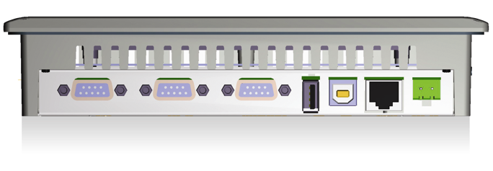
Only here.
professional Panels from VIPA combine the most modern features on the market. Now a further two highlights have been added, that only exist in the professional Panels from VIPA.
Ultra-simple assembly by our patented mounting bracket.
No panel can be built in faster and easier. Guaranteed!
This mounting bracket is firmly integrated in the panel, so that it cannot get lost.
The largest selection of interfaces on a panel.
In fact as many as on an industrial PC: RS232, RS485, RS422, MPI, PROFIBUS-DP Slave, Ethernet RJ45, USB-A and USB-B interfaces, (depending on the version).
A professional Panel can do pretty well as much as an industrial PC and yet consumes less energy.
The three largest professional Panel even have an integrated Ethernet switch.
MPI, PROFIBUS, RS 485 oder CAN
Ethernet 10/100
RS 422/485
RS 232
USB-A
USB-B
Power

Slide 24
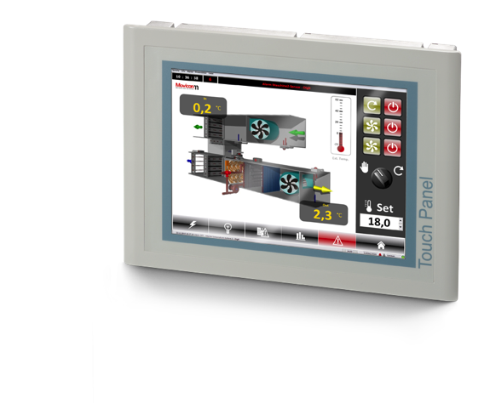
The Panel that is open for everything.
The professional Panel solves basic tasks thanks to the integrated PLC function completely without a control system.
And of course communication also runs with all elements of the engineering level..
professional Panels communicate with all control systems.
Also I/O systems can be controlled directly.
Industrial Ethernet
SQL-Database
ERP & MES
Condition Monitoring

Slide 25
Good Panel, good buy.
Why a professional Panel is a good investment for your plant.

Slide 26
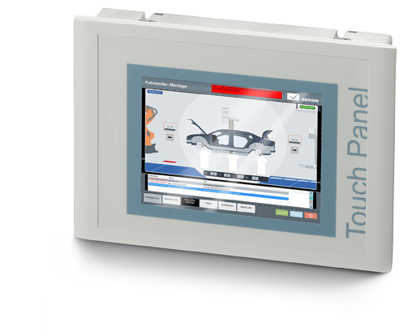
a sustainable investment.
2021
2020
2019
2018
With the professional Panel VIPA has not only paid attention to performance, but also to someting quite different: unique quality.
Due to the special aluminium housing they are so robust that professional Panels last an extremely long time. The heat can also be significantly better dissipated by this housing.
Extended licence: The process on the panel can also be utilized on the PC in the control room without having to configure again.
The professional Panels will continue to be available for a long time – promise.
professional Panels from VIPA are among the most advanced panels on the market. And that will remain so: We are constantly developing them further, to keep our customers on the cutting edge of technology.
Whoever uses professional Panels from VIPA, can expect to be equipped up to date for a long time to come.
2017
2016
2015
2014
2013

Slide 27
professional Panels: Features and Data
All you need to know at a glance.

Slide 28
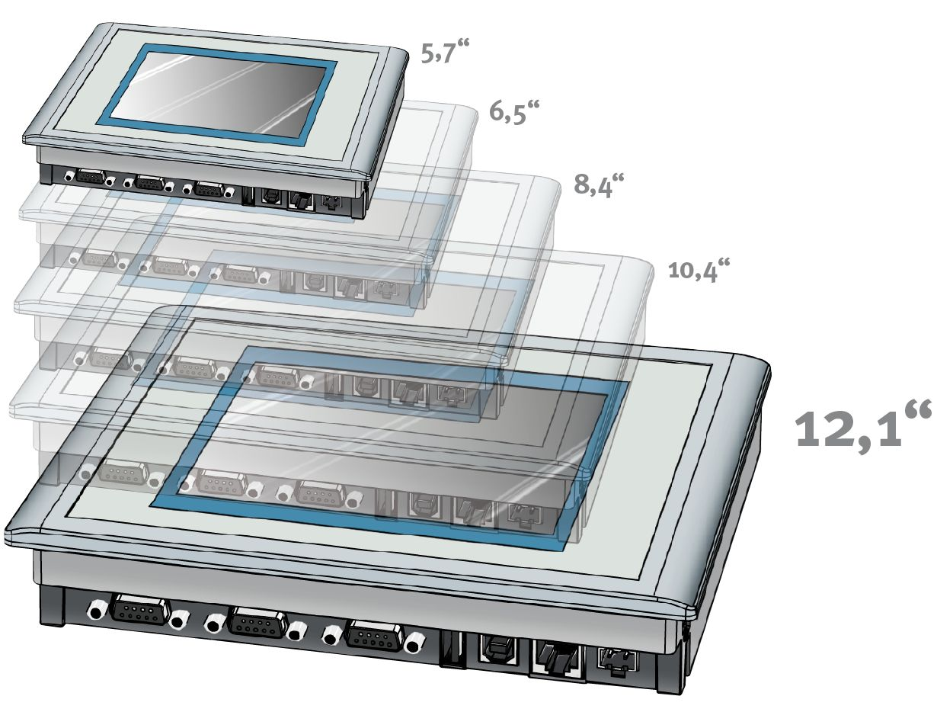
professional Panels in Detail
Up to eight interfaces: RS232, RS485, RS422, MPI-, PROFIBUS-DP Slave, Ethernet RJ45, USB-A and USB-B interfaces (depending on version).
User memory / working memory: 2.048 MB (Flash) / 128 MB (RAM).
Available in five different sizes: 5,7“ to 12,1“.
Particularly small mounting depth of between only 37 to 45 mm.
The panels can be operated both vertically and horizontally.
Operating and configuration friendly.
Extremely durable aluminium housing.
Patented mounting bracket.
Powerful XScale processor with 800 MHz.

Slide 29
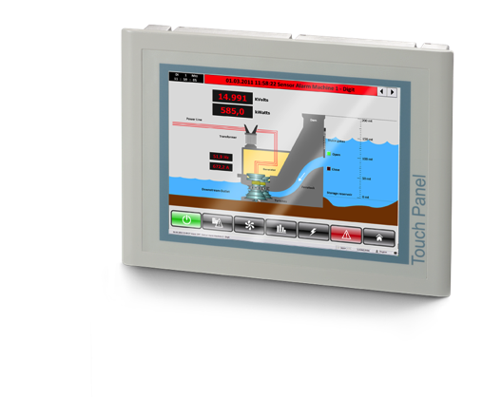
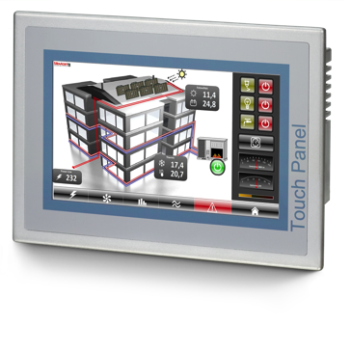
eco or professional? A comparison.
Feature eco Panel professional Panel
Number of possible display sizes 2 5
Number of interfaces up to 5 up to 8
Housing plastic aluminium
Multilingual language support yes. yes.
Integrated web server – yes.
Simple database communication? – yes.
Patented mounting bracket – yes.
Mounting depth 55 to 60 mm 37 to 45 mm
Possible alignment horizontal horizontal and vertical
Processor 533 MHz 800 MHz.
Back to the overview

Slide 30
HMI Panels from VIPA
in practice.

Slide 31
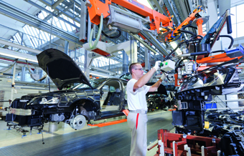
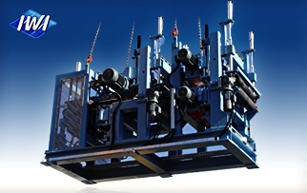
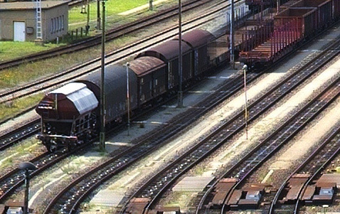
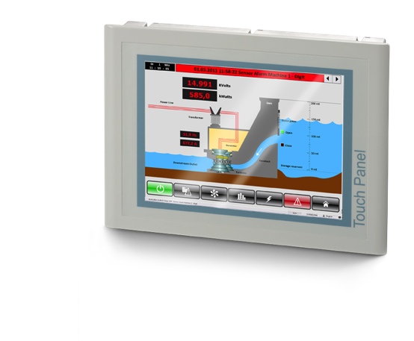
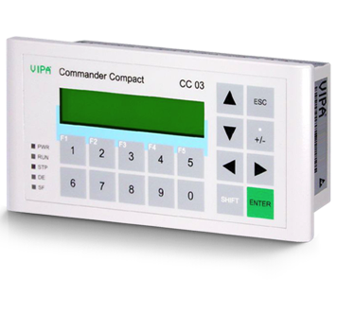
References
Here are just three of the hundreds of companies that control with the help of VIPA panels.
AUDI plc.
The global brand Audi uses the line display CC03.
The display is used here in the assembly stage as information control.
IWI Ltd.
The company relies on eco Panels and Movicon in machine and plant engineering.
IWI Ltd. is the world‘s leading supplier of equipment for processing insulating materials.
FEW Blankenburg Ltd.
The electrodynamic rail brake EDG is controlled with professional Panels.
Manual, semi or fully automatic control is possible.
It can be deployed as a mountain, valley, intermediate or direction brake.

Slide 32
conclusion

Slide 33
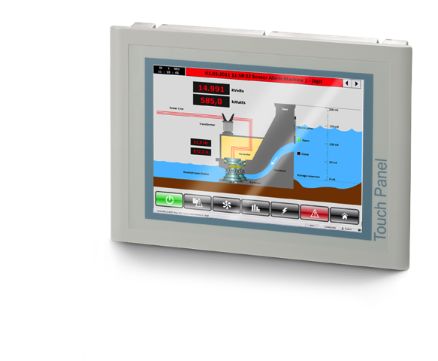
A good choice. Do you remember why?
Line displays from VIPA:
extremely low-priced,
more than sufficient for basic tasks
easy to handle,
enormously robust .
eco Panels from VIPA:
powerful Touch Panels,
very solid and durable,
remarkably fast,
open for many systems, applications and uses,
exceedingly good value for money.
professional Panels from VIPA:
Touch Panels with web server,
simple database communication possible,
all professional Panels can be controlled from every PC in the company,
powerful processors,
open for many systems, applications and uses and even for your Runtime,
uniquely easy assembly,
very solid and durable.

Slide 34
Many thanks

